Slide 1


Full HD Webcam with autofocus
TLL491131

Slide 2
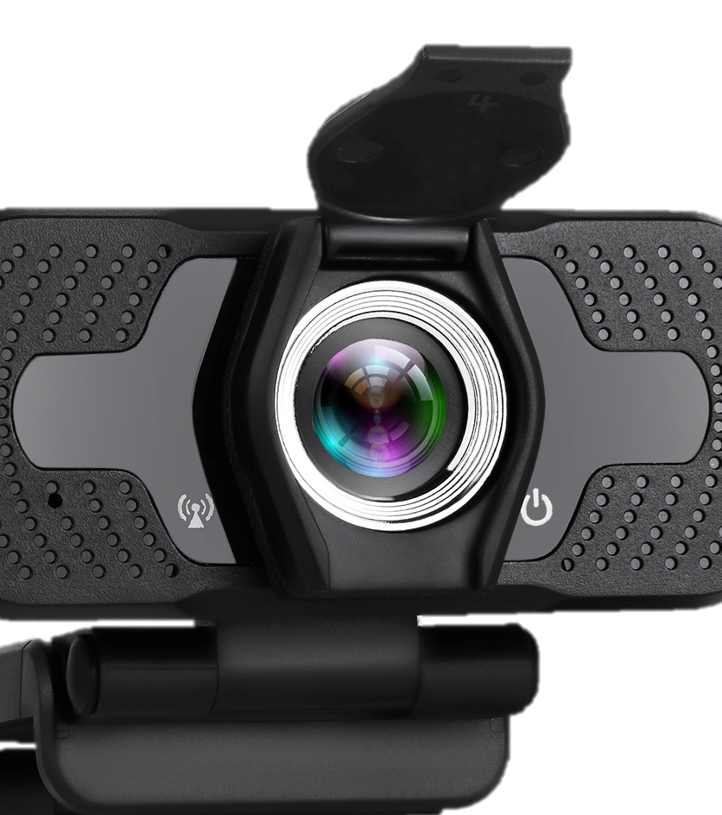

Full HD Webcam with autofocus
In Focus
Autofocus. Full HD. Plug & Play.
Characteristics:
Full HD resolution - the best choice for webinars and video conferencing
Autofocus and wide-angle lens for sharp, crystal clear images
Built-in noise reduction microphone for a clear conversation
Plug and Play connection, easy to use
Join your team's video conference, your online courses or favorite webinars in full HD resolution with our webcam.
Just plug it in the USB port of your computer or other device and the webcam is ready to film! Thanks to the autofocus function, you can move and talk naturally in front of the camera and your videos will always be sharp and crystal clear.
Designed to provide security and peace of mind, the webcam has a built-in privacy cover that will protect the lens when it is not in use. This makes impossible for hackers and other virtual threats to invade your privacy. The webcam also has a built-in noise reduction microphone that will ensure a clear conversation.

Slide 3
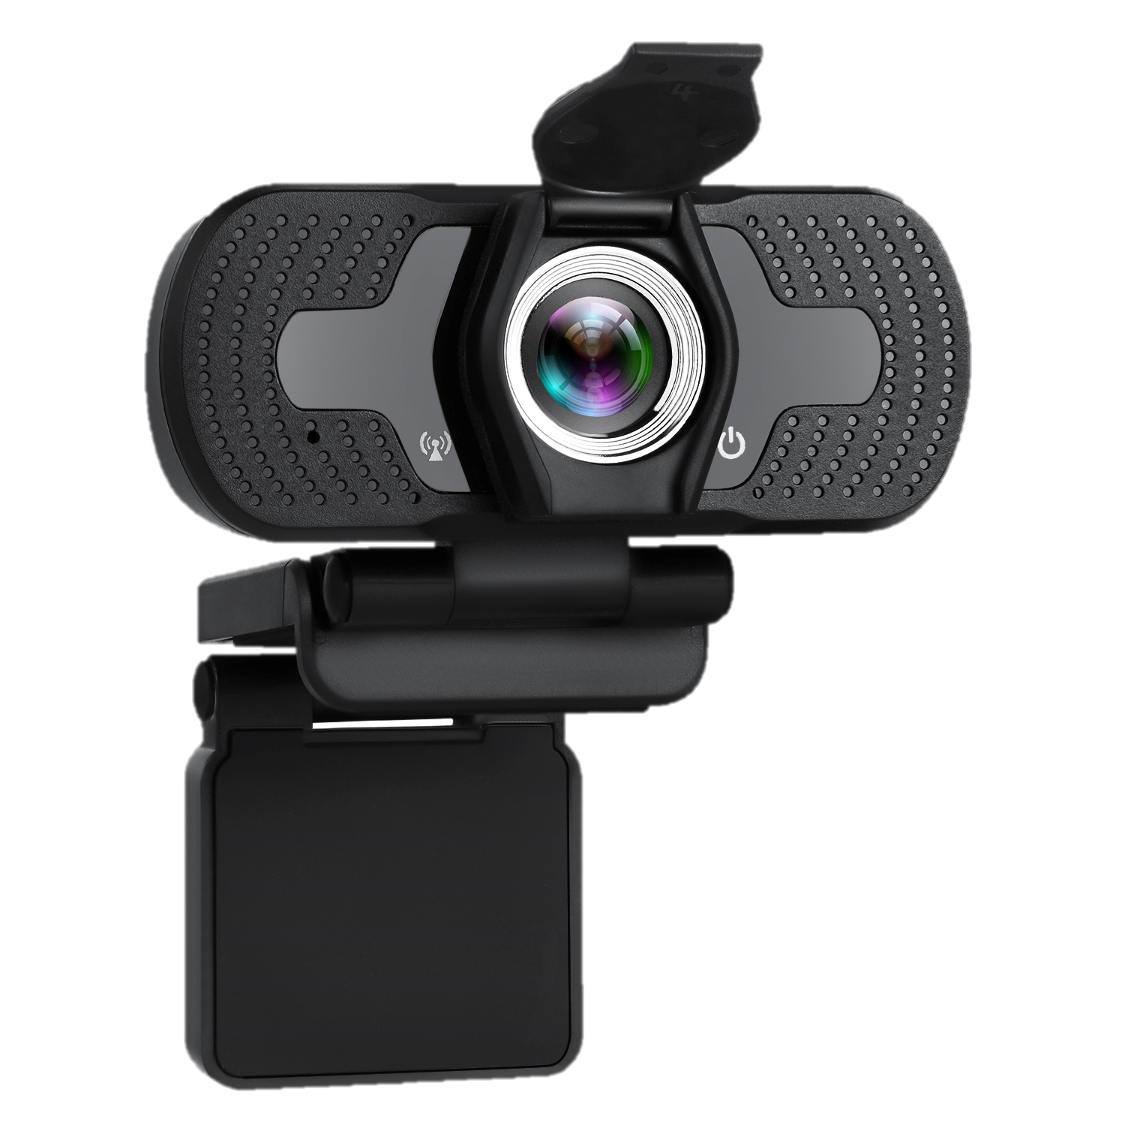
Full HD Webcam with autofocus
In Focus
Autofocus. Full HD. Plug & Play.
Technical specs
Image sensor: | 1/2.7 2MP
Video resolution: | 1920x1080 (Full HD)
Video frame rate: | 30 fps
Focus type: | Autofocus
Built-in microphone: | Yes
Field of view: | 97°
Audio encoding format: | PCM
Encoding format: | MJPEG
Power supply: | USB DC 5V
Cable length: | 150cm
Features: | Privacy cover, Automatic low light correction
Compatible with: | Windows® 10 or later, Windows 8, Windows 7, Mac OS
Dimensions: | 85 x 71.4 x 32 mm
Weight: | 98g
Color: | Black
Package includes: | 1 x Web camera, 1 x Manual
Package dimensions: | 110 x 85 x 65 mm
Package weight: | 136g
Product code: | TLL491131
EAN: | 5949120003100

Slide 4
THANK YOU!
For more products visit our website
www.tellur.com

