Slide 1


Earphone Pouch
TLL121935

Slide 2
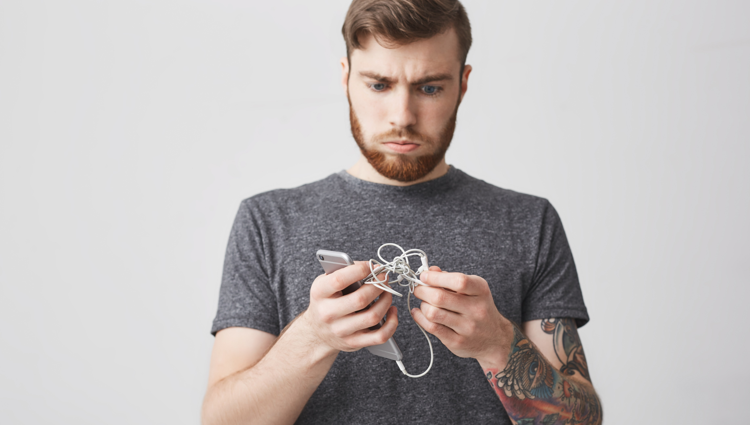
Earphone Pouch
Safe Sound
No more tangled earphones!
You can change this
with a stylish earphone Pouch.

Slide 3
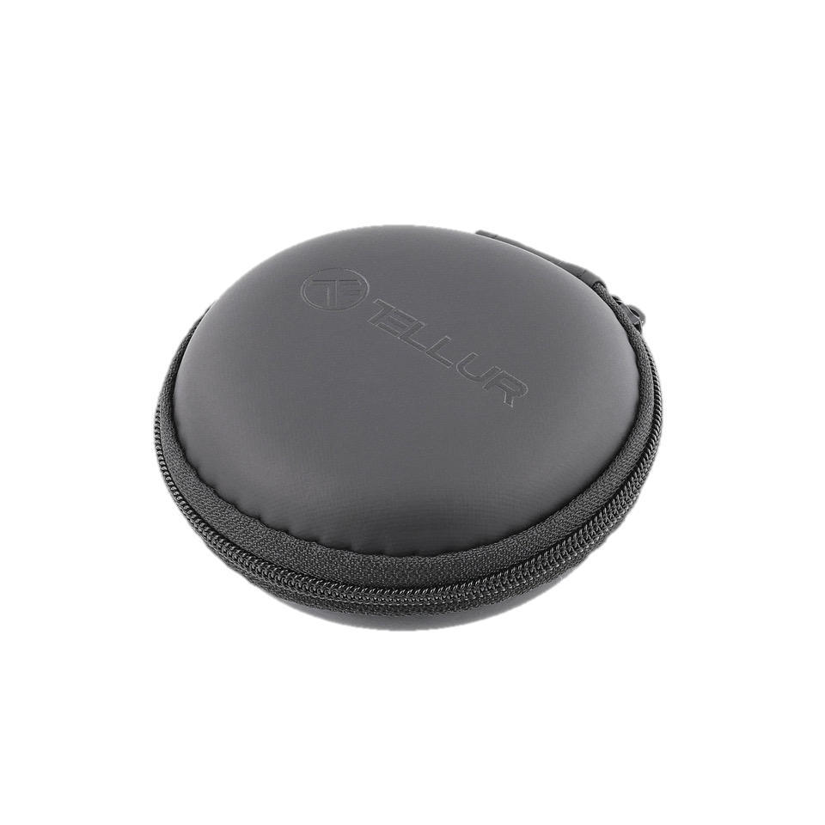
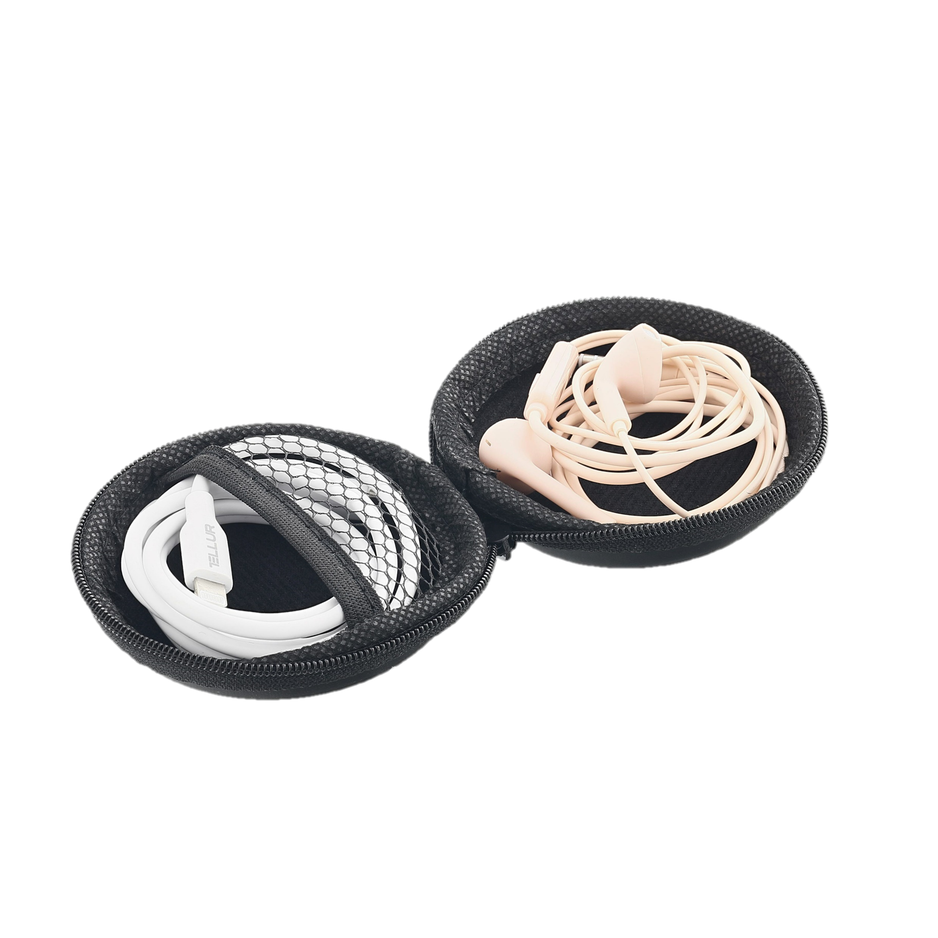
Earphone Pouch
Safe Sound
A stylish, handy pouch to store your earphones.
Made of water-resistant material, with an interior of microfiber, the pouch will become a multifunctional and portable small bag, suited for a variety of small accessories.
The 360 degree zip surround protect your headphones from scratches, water, dirt and dust.
This pouch has a hard case for keeping your headphones tidy in your backpack, carry-on or luggage for improved traveling protection.

Slide 4
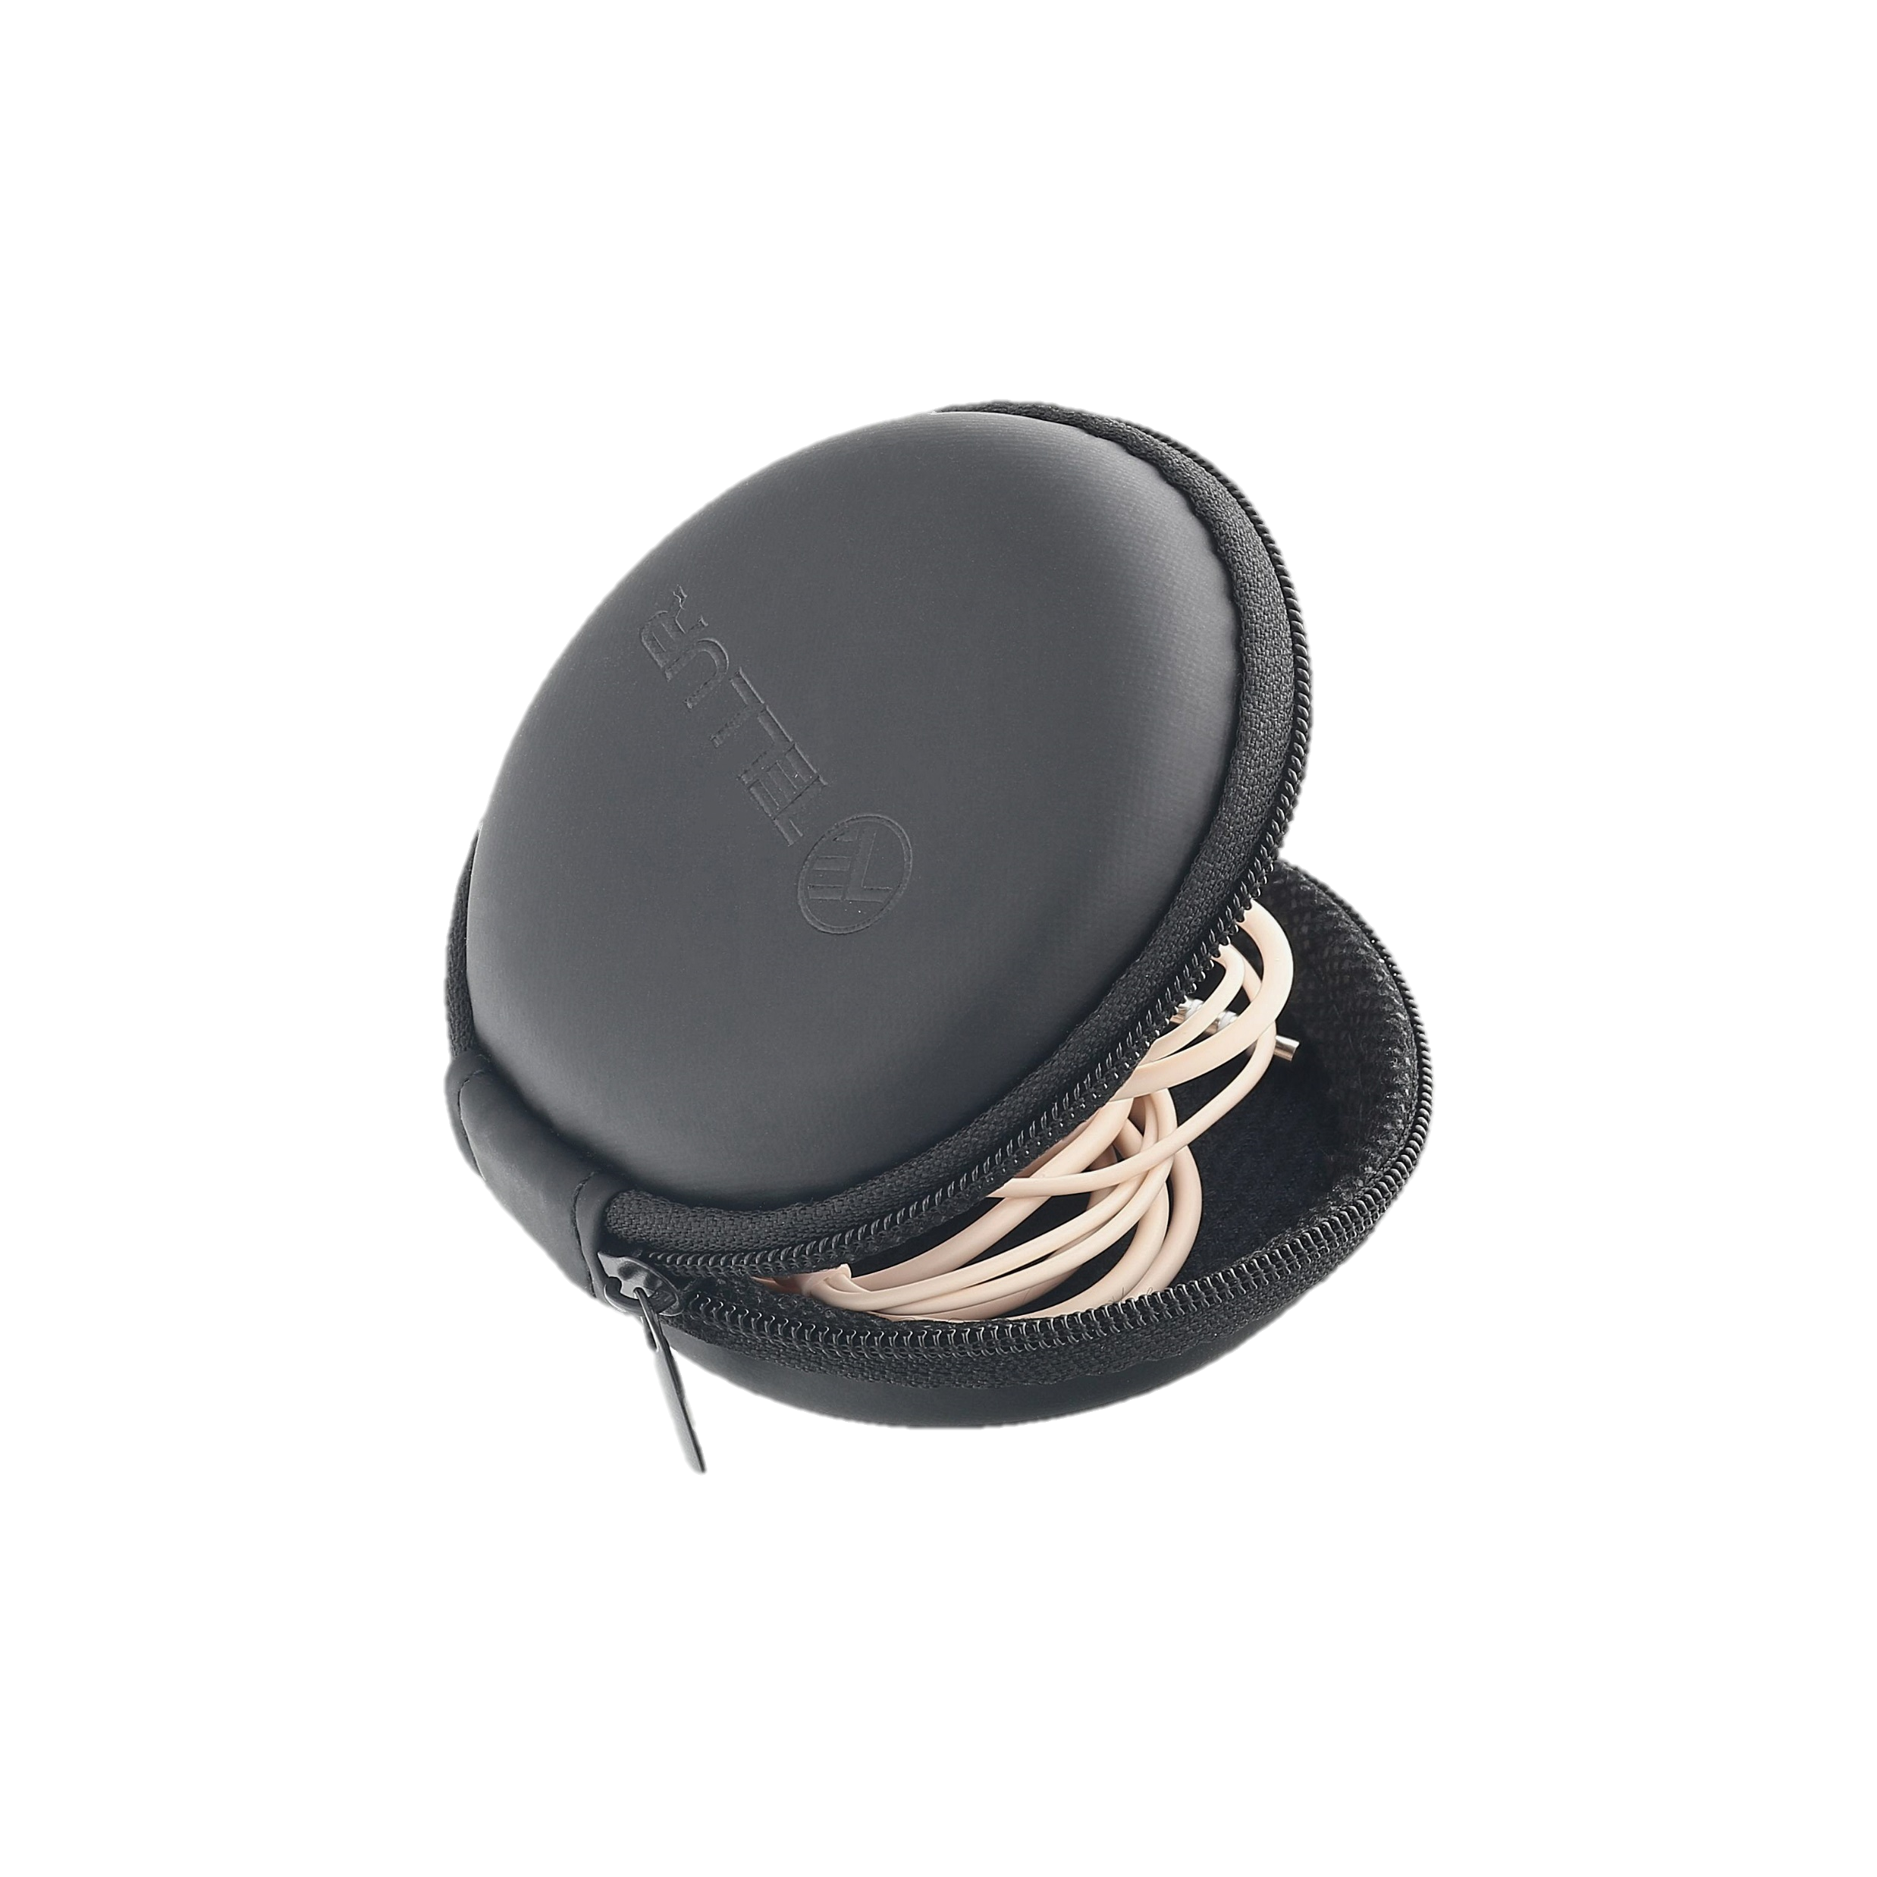
Earphone Pouch
Safe Sound
A sturdy, hard-shell case to keep your headphones tidy
The case can suit a variety of purposes, holding memory cards, jewellery, cables, SIM cards etc
Zipper closure and microfiber interior
The water-resistant material keeps your headphones safe from unwanted incidents
Technical specs
Material | Eva
Form | Round
Color | Black
Product dimensions | 80x80x30mm
Product weight | 23 grams
Package include | 1 x Pouch for Earphones
Warranty: | 2 years
Product code: | TLL121935
EAN: | 5949120001083

Slide 5

Earphone Pouch
Safe Sound
Your earphones will love you more!

Slide 6
THANK YOU!
For more products, please visit
www.tellur.com

